Slide 1
Learn to Code Session 1

Slide 2
Agenda
Intro - Engineering at Living Social
How this all works
Two sessions tonight:
HTML/CSS instruction with Robert
Self-paced intro to Ruby
Homework assignments

Slide 3
Intros
HELLO!
We are developers
We love to code
We want you to love coding too
Fabulous mustaches are optional

Slide 4
Engineering at Living Social v1.0
in the beginning…
One Rails app
5,100 lines of code

Slide 5
Engineering at Living Social today
ecosystem now
40+ apps
150,000 lines of code
Not including in-house gems and native apps
Multiple languages: Ruby, HTML, CSS, Clojure, Java, Javascript, Objective C, Scala, JRuby, etc

Slide 6
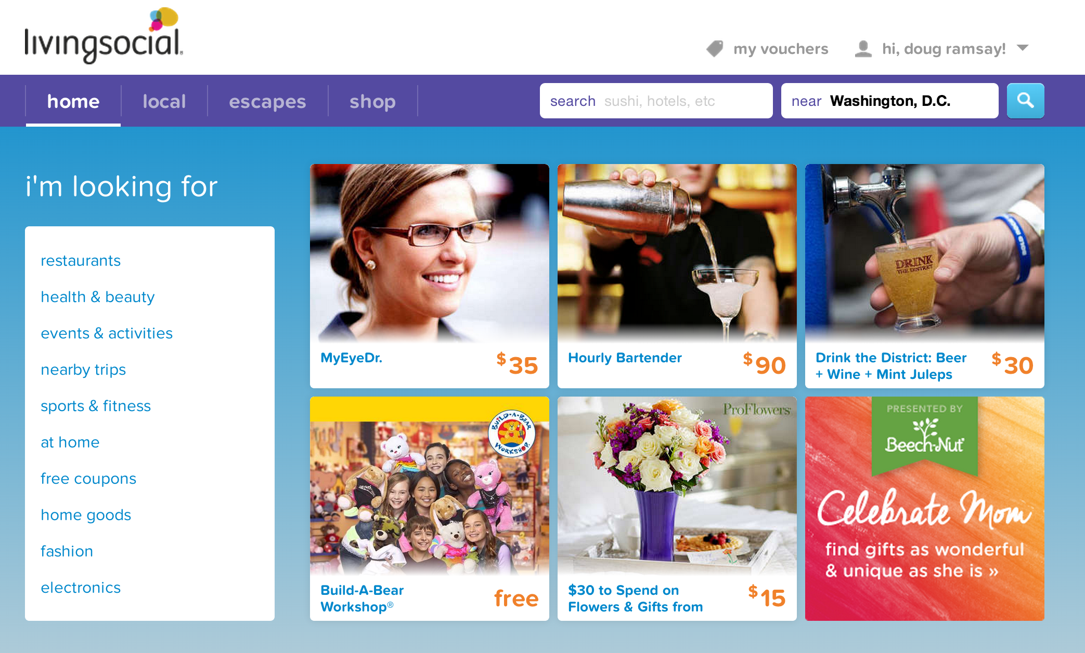
What makes this go?

Slide 7
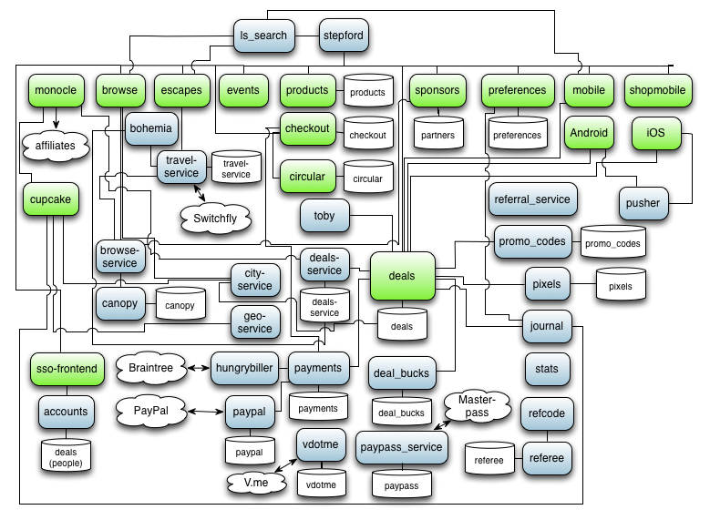
This!

Slide 8


Slide 9
Don’t Panic!
We’ll be gentle

Slide 10
Methodology
Start Simple, iterate from there
What are the parts of a web application?
Building block approach – we’ll learn it one technology at a time

Slide 11
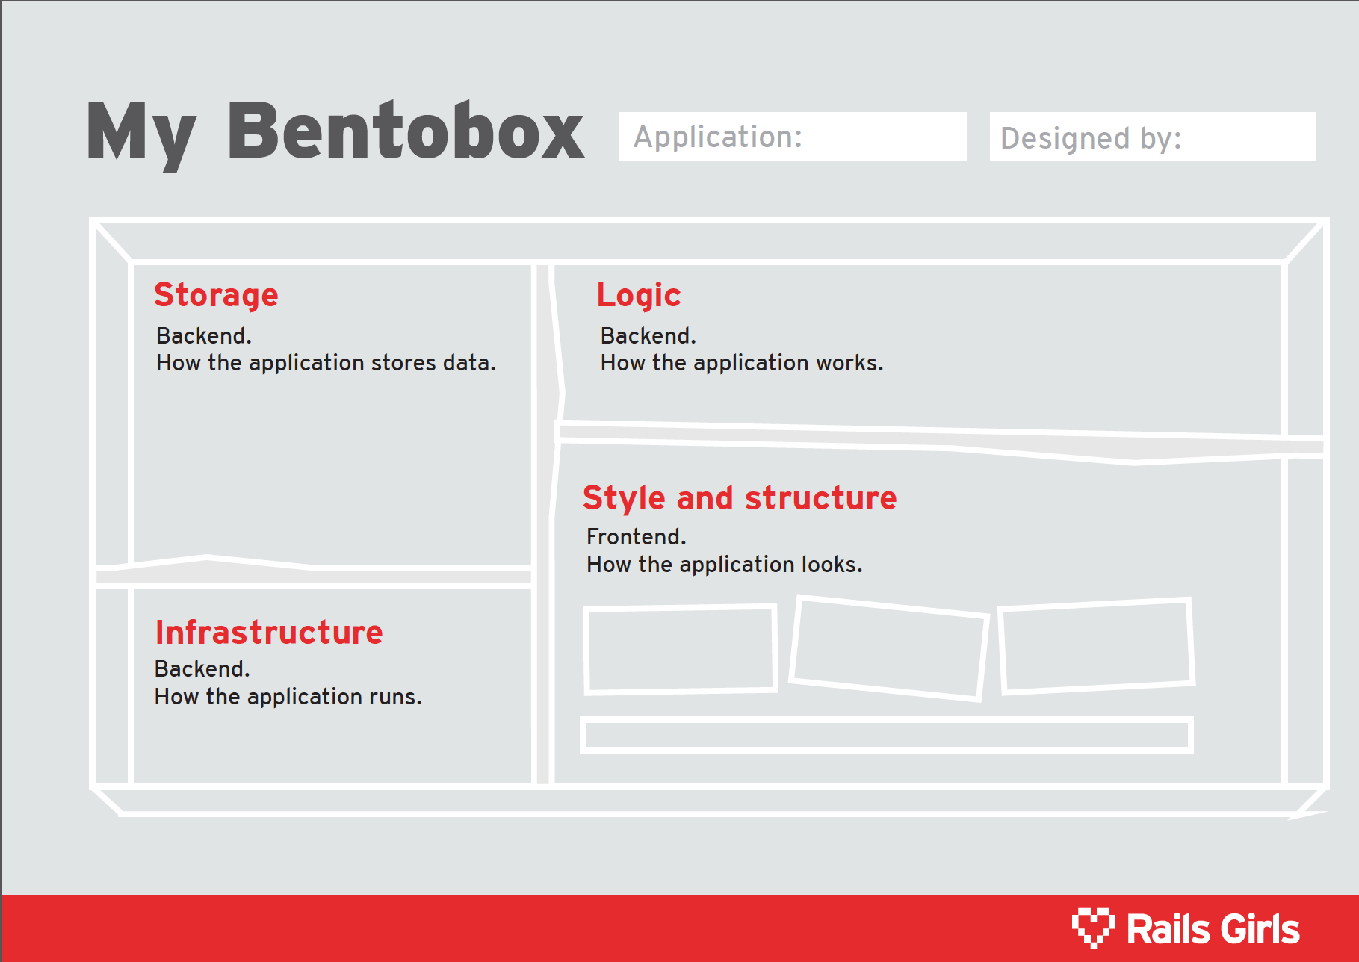
Python
Ruby
Rails
MySQL
HTML
CSS
JavaScript
Servers
Unicorn

Slide 12
How this is going to work
Self-paced learning
Start simple, learn new languages as we go
Monthly evening teaching session
Suggested tutorials of the month
Learning lunches bi-weekly to cover homework, get help from devs, ask questions

